Slide 1
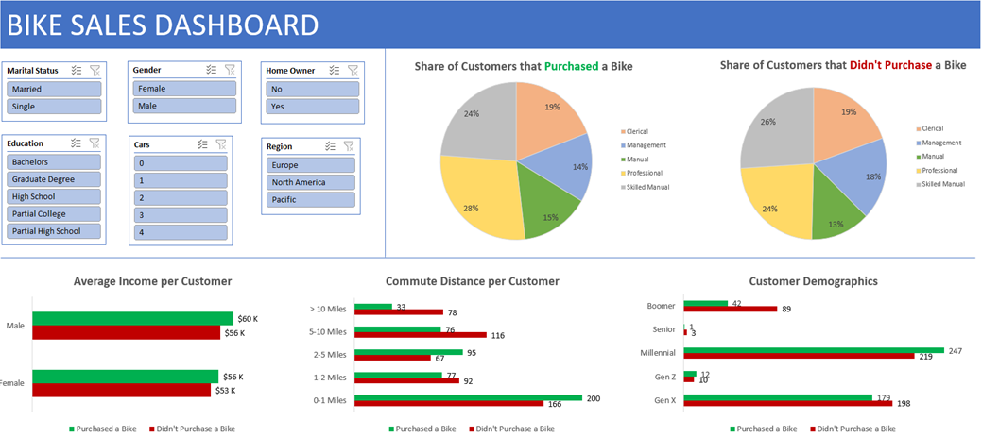

Slide 2
Abstract
I conducted an exploratory analysis of a biking dataset.
I conducted my analysis via these metrics:
Average Customer Income
Commute Distance per Customer
Customer Demographics
Share of Customers that Purchased and did not Purchase a Bike
I included slicers for the end user to analyze the data via these metrics:
Marital Status
Gender
Homeowner
Education
Number of Cars
Region

Slide 3
Insights
From my analysis, I have discovered the following insights:
The average customer income did not vary much between genders or whether a customer purchased a bike.
Customers who commuted short distances purchased the most bikes.
Younger customers purchased the most bikes.
Millennials purchased the most bikes.
Seniors purchased the least bikes.
The customers’ area of work was evenly distributed.
Professional workers purchased the most bikes.
Mostly skilled manual laborers didn’t purchase a bike.

Slide 4
Recommendations
I propose the following strategy for profit maximization:
Concentrate marketing campaigns in big cities.
Millennials, the age demographic that purchased the most bikes, tend to live in big cities.
This strategy will maximize the number of potential buyers.
Build more bike stores that are closer to areas with many homes.
If the bike stores are closer to homes, the commute time to the stores will be shorter
This strategy will also maximize the number of potential buyers.

Slide 5
Project Link
https://www.youtube.com/watch?v=opJgMj1IUrc&list=PLUaB-1hjhk8H48Pj32z4GZgGWyylqv85f&index=9&t=1684s

